Slide 1
VPC with 2 EC2 Instances(Web /App Servers) L Prasanna Devi

Slide 2
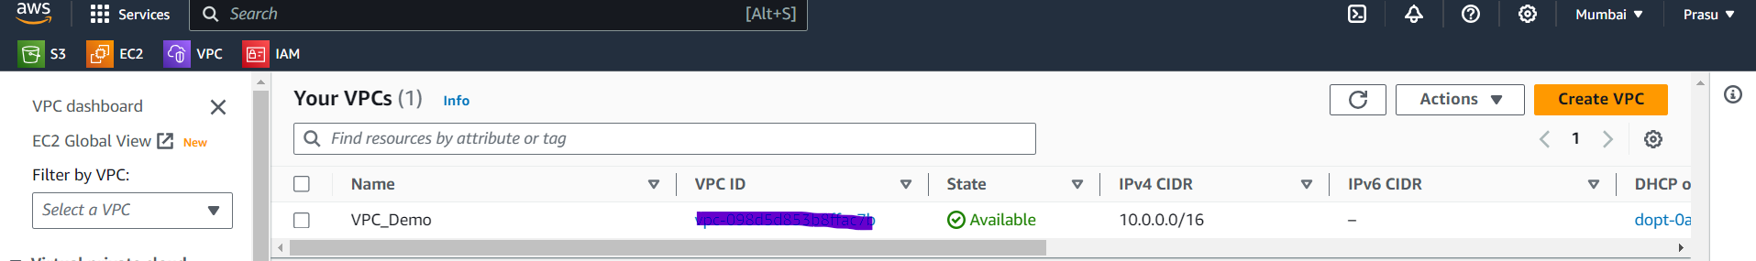
VPC Creation: Lets create a VPC

Slide 3
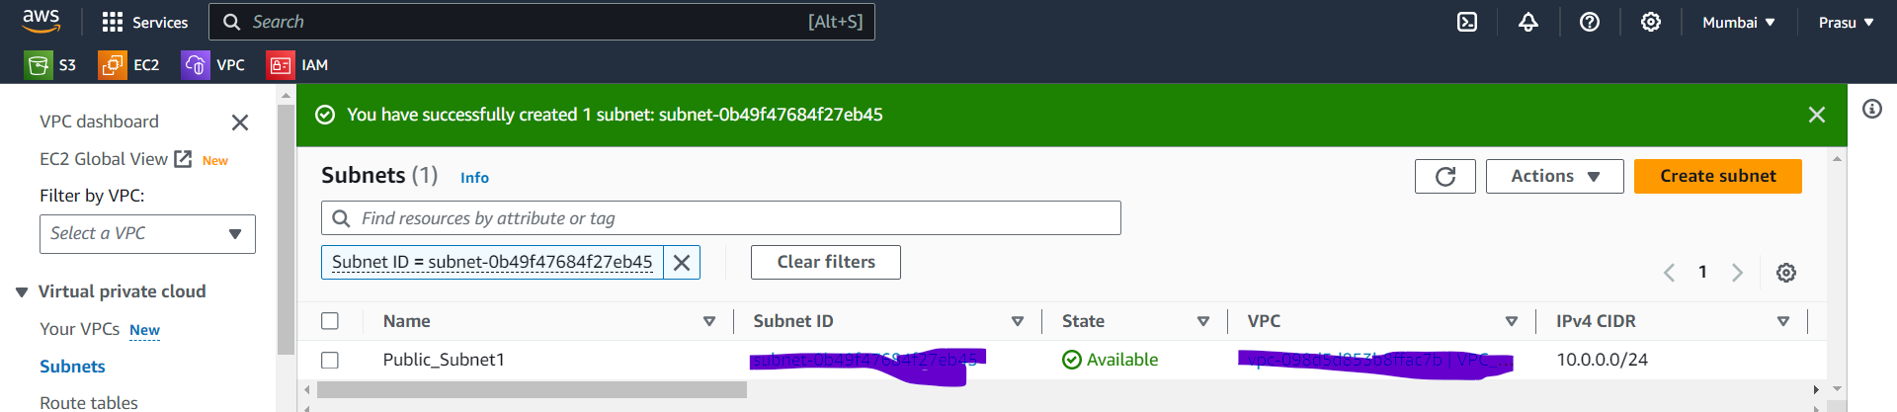
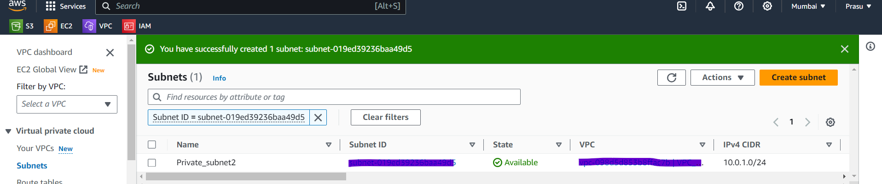
Subnet Creation: Let's create 2 Subnets 1 Public (For Webserver) and 1 Private(For Application Server).

Slide 4
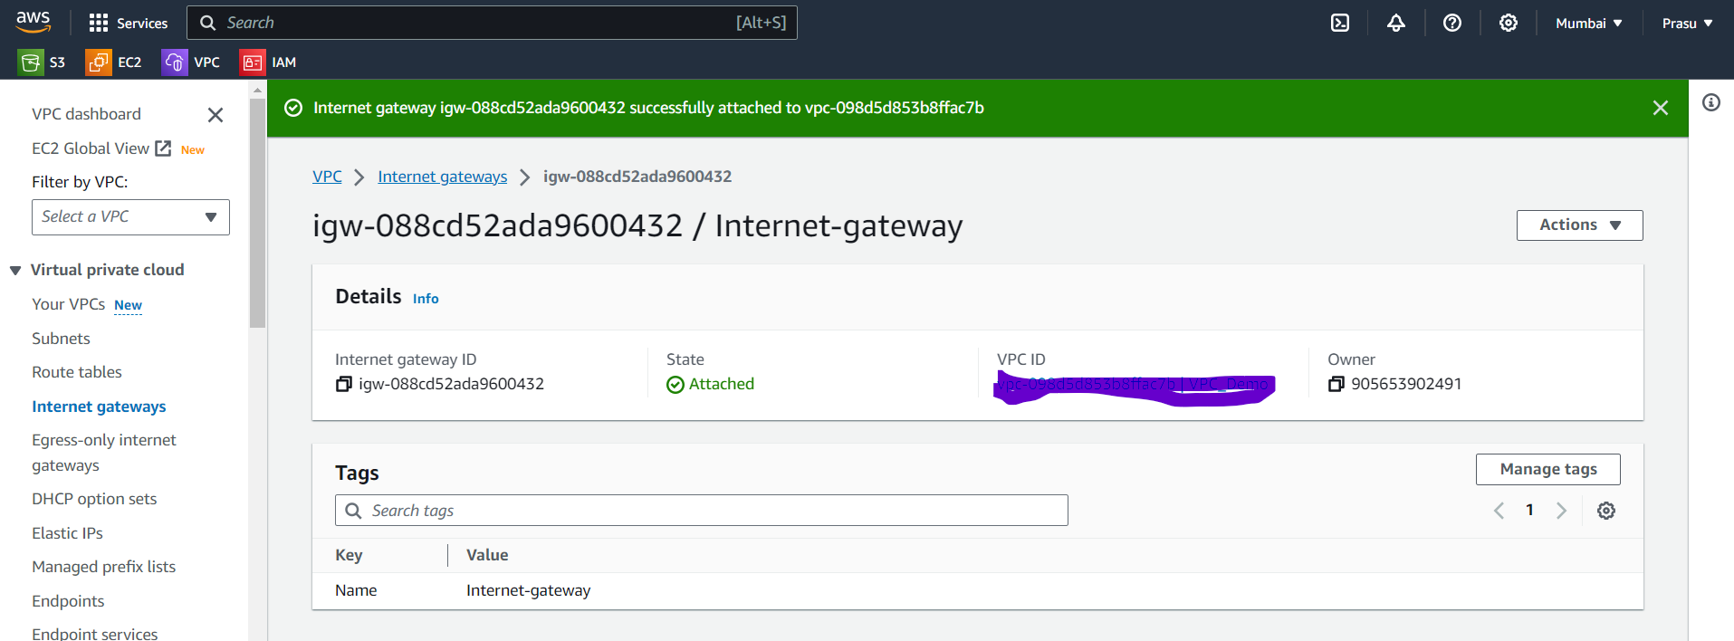
Internet Gateway Creation: In order to make communication between Public Subnet to External Internet world, we need to create Internet gateway and attach to VPC which we created.

Slide 5
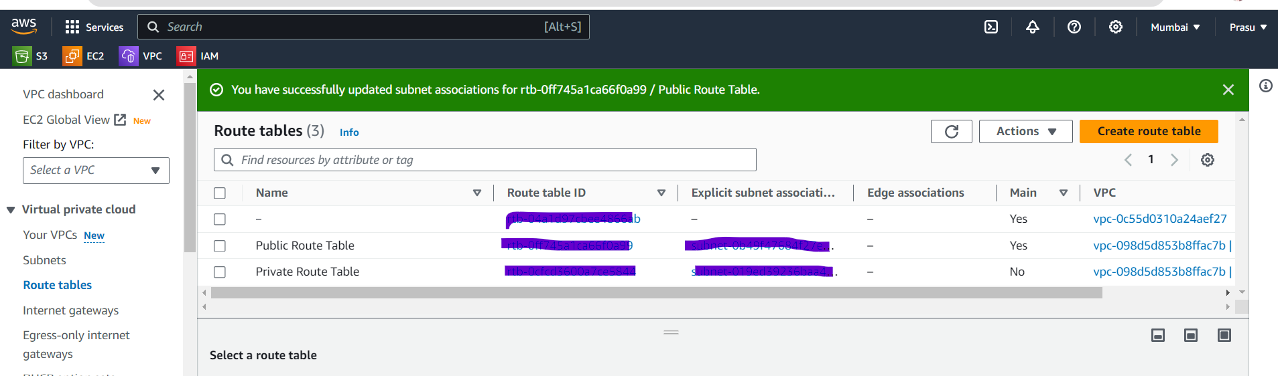
Route Table updates: Create new Route table for Private Subnet, Associate Subnet’s to both Route tables. (i.e). Association makes communication easy Public Route Table >> Public Subnet Private Route Table >> Private Subnet

Slide 6
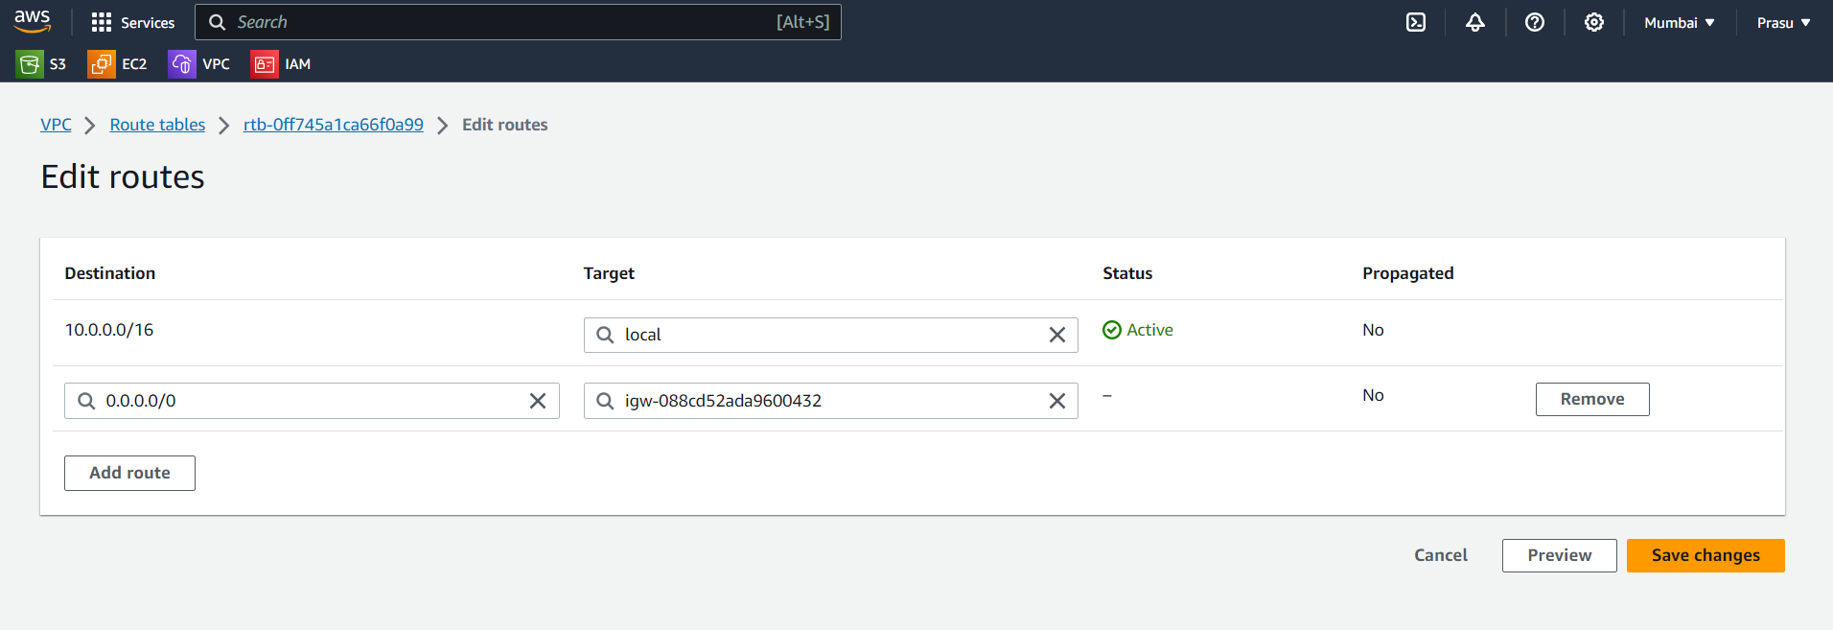
Route open for Internet Gateway: In order to make communication (Internet) between I.G and Public subnet, we need to add route entry for Internet Gateway.

Slide 7
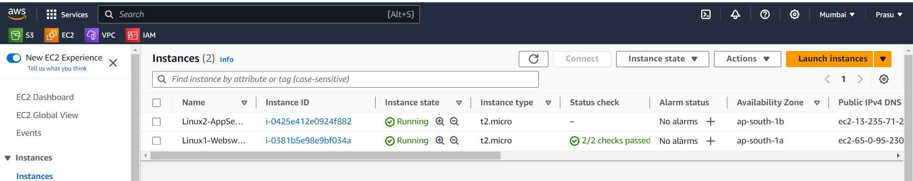
Create 2 EC2 Instances: Create 2 EC2 Instances Linux1 EC2: For Web Server in Public Subnet (with HTTP port 80) Linux2 EC2: For Application Server in Private Subnet(Due to Security reason we will keep it in Private Subnets)

Slide 8
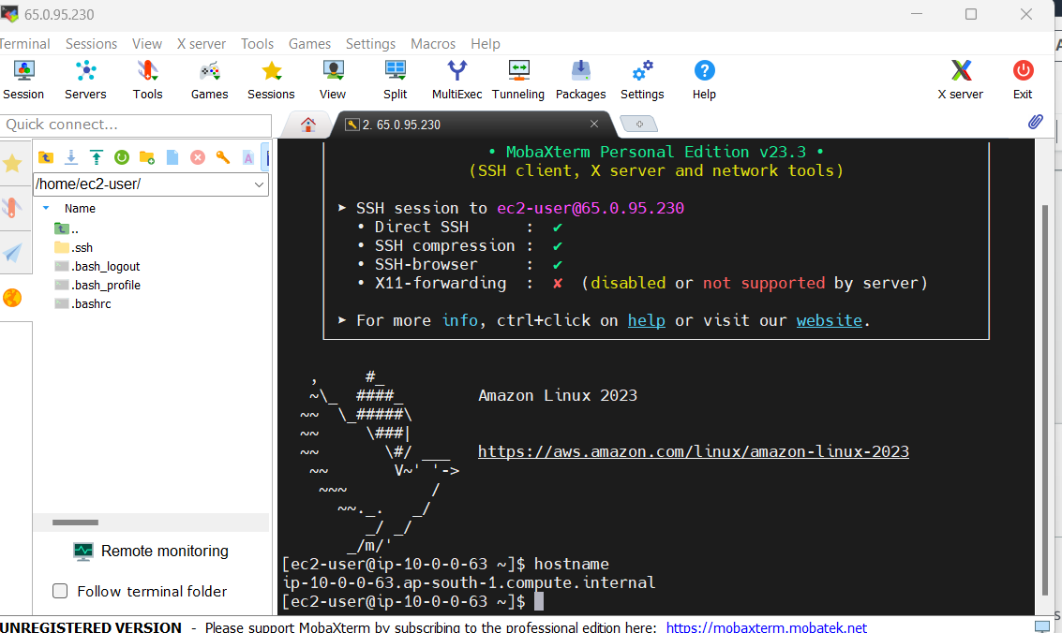
Access Linux1(Web Server): As we have EC2 (Web server) ready, lets access it using SSH Protocol.

Slide 9
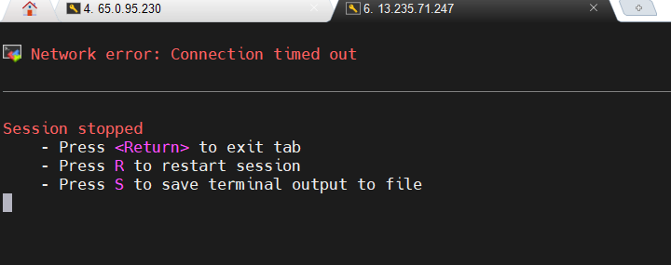
Access Linux2(Application Server): Let's try to access Linux2 Server(App). This will not work as the server is in Private Subnet and not exposed to External Internet. This is expected.

Slide 10
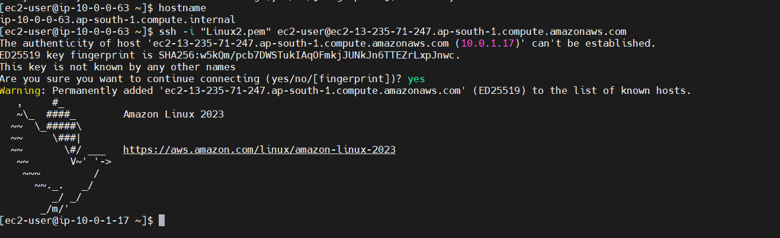
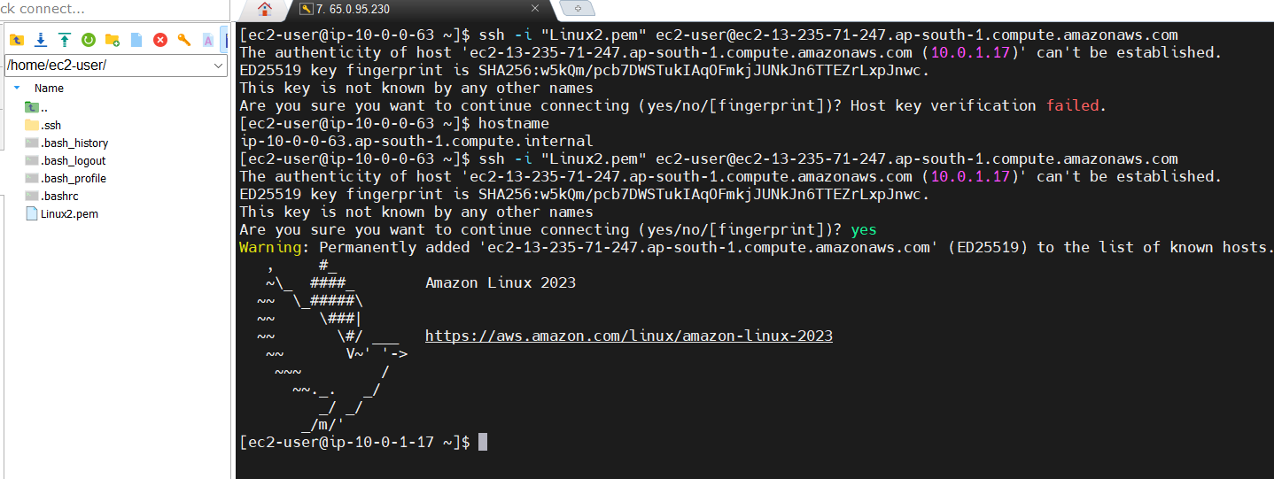
Access Linux2(App Server) from Linux1(Web Server): Since default Route is open between Private subnet(Application server) and Public Subnet(Web server) in same VPC, We can access App server from Web server. (i.e) SSH to Linux server (Web server) > Upload Pem file of App server> ssh to App server

Slide 11
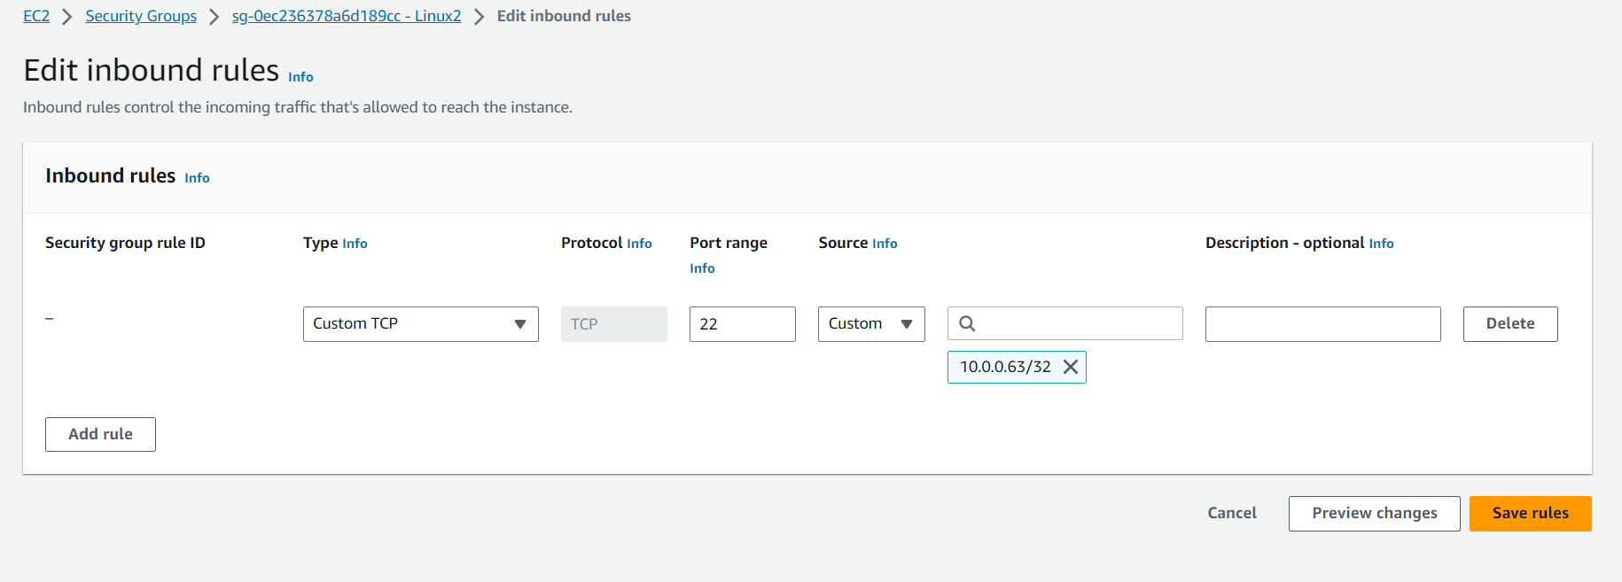
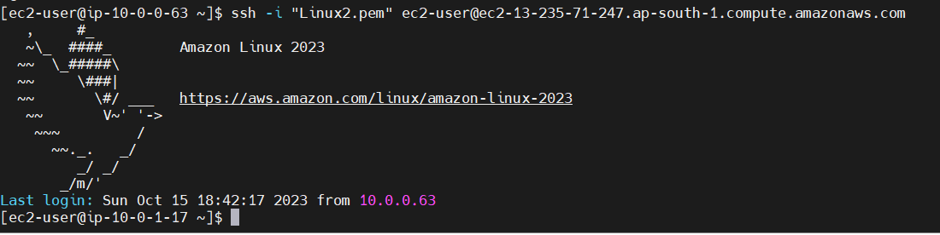
Open communication for Web server > App server: We want to open a dedicated communication between Web server to App server then we will add the Private IP (Web server) in Security Group of (App server). Basically, by adding this route will allow both server to communicate.

Slide 12
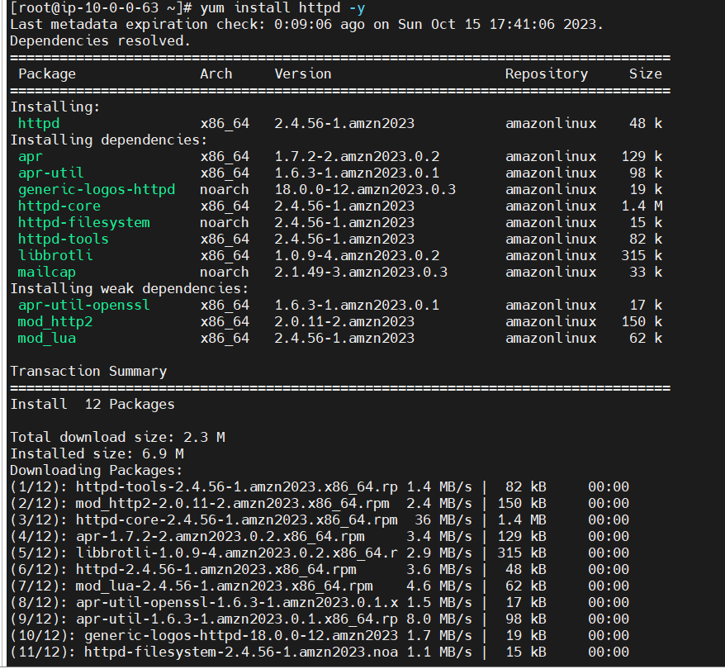
Install Http service in Linux1(Web Server): In order to create html, we need to install Http Service package in Web server by using “yum install”

Slide 13
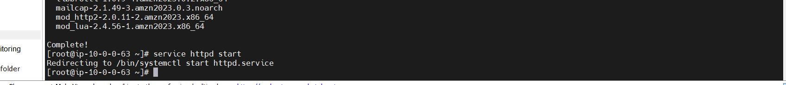
Start the httpd service: After Installaling http package, start the httpd service by below command.

Slide 14
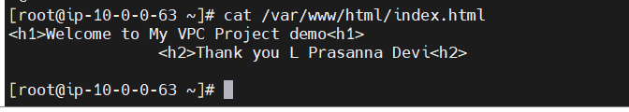
Write HTML code: Update the Code/comments in Index.html file in vim editor and save it. Validate the same before accessing.

Slide 15
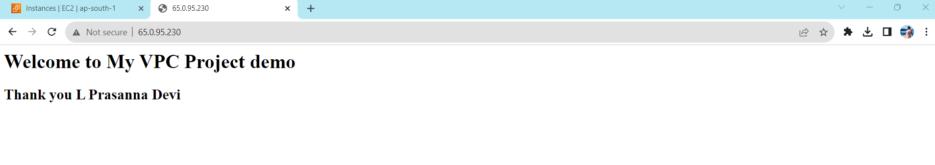
Access the Web Page: Try accessing the Public IP of Linux1(Web server). This means Linux2(Web server) is communication with external Internet on port 80. We can see the HTML code executed.

